Slide 1
Linux Installation and Usage
Chapter 2

Slide 2
Objectives
After completing this chapter, you will be able to:
Prepare for and install Fedora Linux using good practices
Outline the structure of the Linux interface
Enter basic shell commands and find command documentation
Properly shut down the Linux operating system

Slide 3
Installing Linux (1 of 2)
Preparing for installation
All OSs require a minimum set of hardware components to function properly
Obtained from manual or file in DVD of OS, or vendor website
Each hardware component should be checked against the Hardware Compatibility List (HCL) found on the vendor’s website

Slide 4
Installing Linux (2 of 2)
Table 2-1: Fedora 28 recommended minimum hardware requirements
Type of hardware | Requirement
Central processing unit (CPU) | 1GHz or faster Intel x64 CPU
Random access memory (RAM) | 1GB
Free disk space (permanent storage) | 10GB free space
Additional drives | DVD drive (for DVD-based installation)
Peripheral devices | Fedora-compliant peripheral devices (e.g., video cards, sound cards, network cards)

Slide 5
Understanding Installation Media (1 of 6)
The most common source for Linux packages and installation program is DVD media
To install form DVD, place the Linux DVD in the DVD drive and turn on the computer
Most Linux distributions provide a website from which you can download DVD images (called ISO images)
Can be written to a blank writable DVD using disc burning software

Slide 6
Understanding Installation Media (2 of 6)
Many Linux websites also allow you to download a bootable live media DVD image
A fully functional graphical Linux OS is loaded into RAM
Allows you to test the OS on your computer to ensure all hardware drivers were detected properly
Computer does not have a DVD drive
Install Linux by imaging the DVD or live media DVD image to a USB flash drive

Slide 7
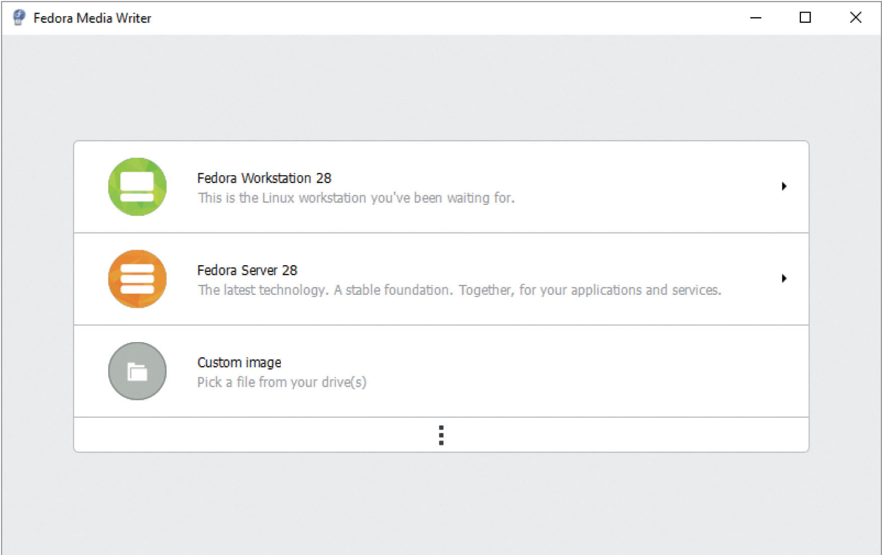
Understanding Installation Media (3 of 6)
Figure 2-1 The Fedora Media Writer tool
Source: Red Hat, Inc

Slide 8
Understanding Installation Media (4 of 6)
Virtualization software: used to run an OS within an existing OS concurrently
Microsoft Hyper-V
VMWare
Oracle VM VirtualBox
Virtual machine (VM): each OS that is run within virtualization software
Virtual machine host (VM host): underlying OS running the virtualization software

Slide 9
Understanding Installation Media (5 of 6)
To install Linux as a VM
Download the standard DVD or live media DVD ISO image to a directory on your VM host
Open virtualization software and choose to create a new virtual machine
Specify the location of the appropriate ISO image
Virtualization software will boot from the ISO image directly

Slide 10
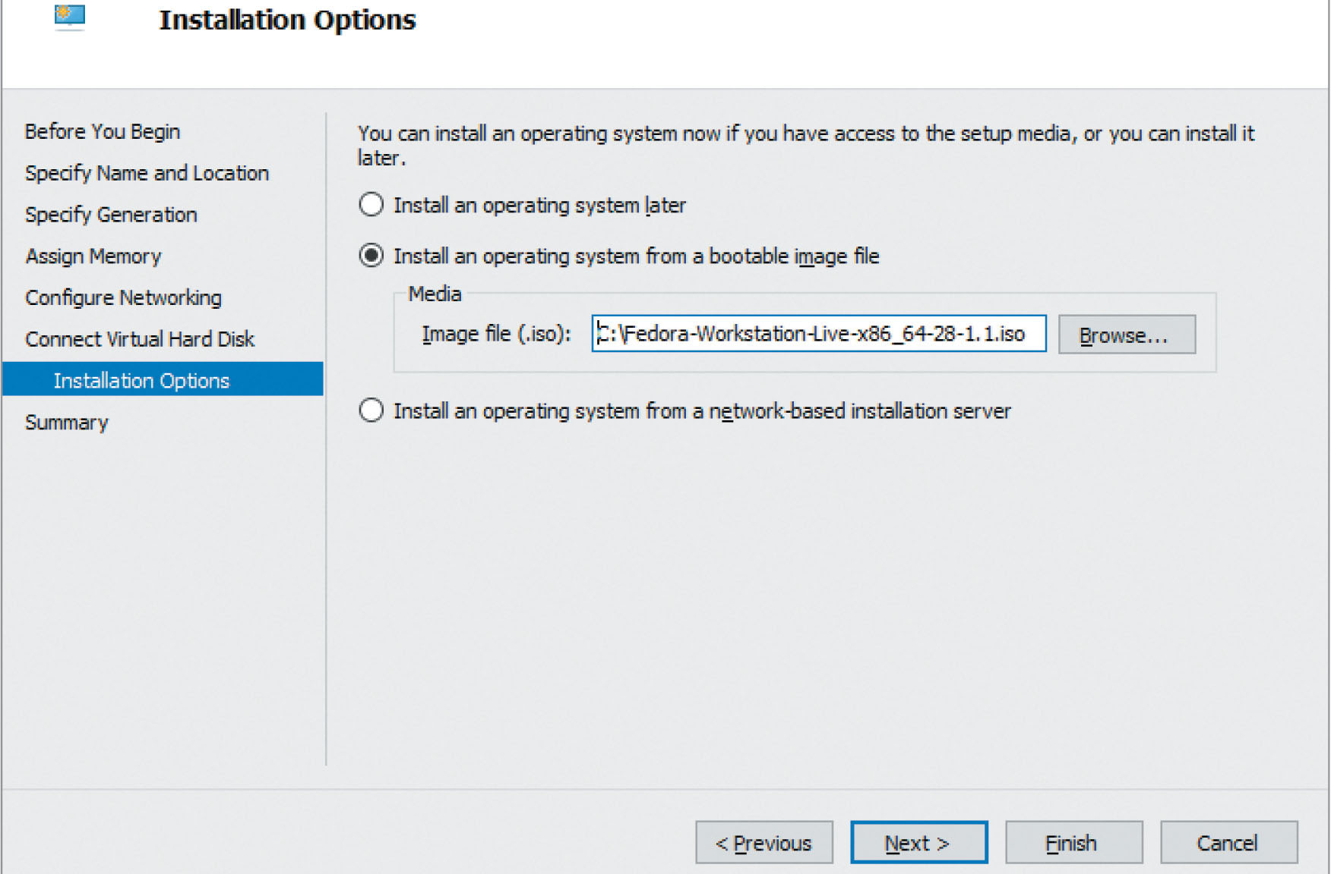
Understanding Installation Media (6 of 6)
Figure 2-3 Selecting installation media within the Hyper-V New VM Wizard
Source: Red Hat, Inc

Slide 11
Performing the Installation
General stages of the installation program for Fedora 28 Linux
Starting the installation
Choosing an installation language as well as localization and system options
Configuring disk partitions and filesystems
Configuring user accounts

Slide 12
Starting the Installation (1 of 2)
Boot from Fedora installation media
You will be prompted to:
Start the installation
Perform troubleshooting actions
If you select the troubleshooting option, you will be presented with four additional options
Start Fedora-Workstation-Live 28 in basic graphics mode
Run a memory test
Boot from local drive
Return to main menu

Slide 13
Starting the Installation (2 of 2)
In most cases, the troubleshooting options are not necessary when installing Fedora Linux
Simply choose Start Fedora-Workstation-Live 28 to start a live Fedora system
Once loaded, you will be presented with a welcome screen that prompts you to install Fedora Linux on permanent storage
If you choose Install to Hard Drive, the Fedora installation program will start

Slide 14
Choosing an Installation Language and Localization and System Options (1 of 4)
You will be prompted to choose installation language
Keyboard model and layout are automatically detected
Network interface is set to obtain network configuration automatically using the DHCP protocol
Date and time are automatically obtained from the Internet if network has Internet connectivity

Slide 15
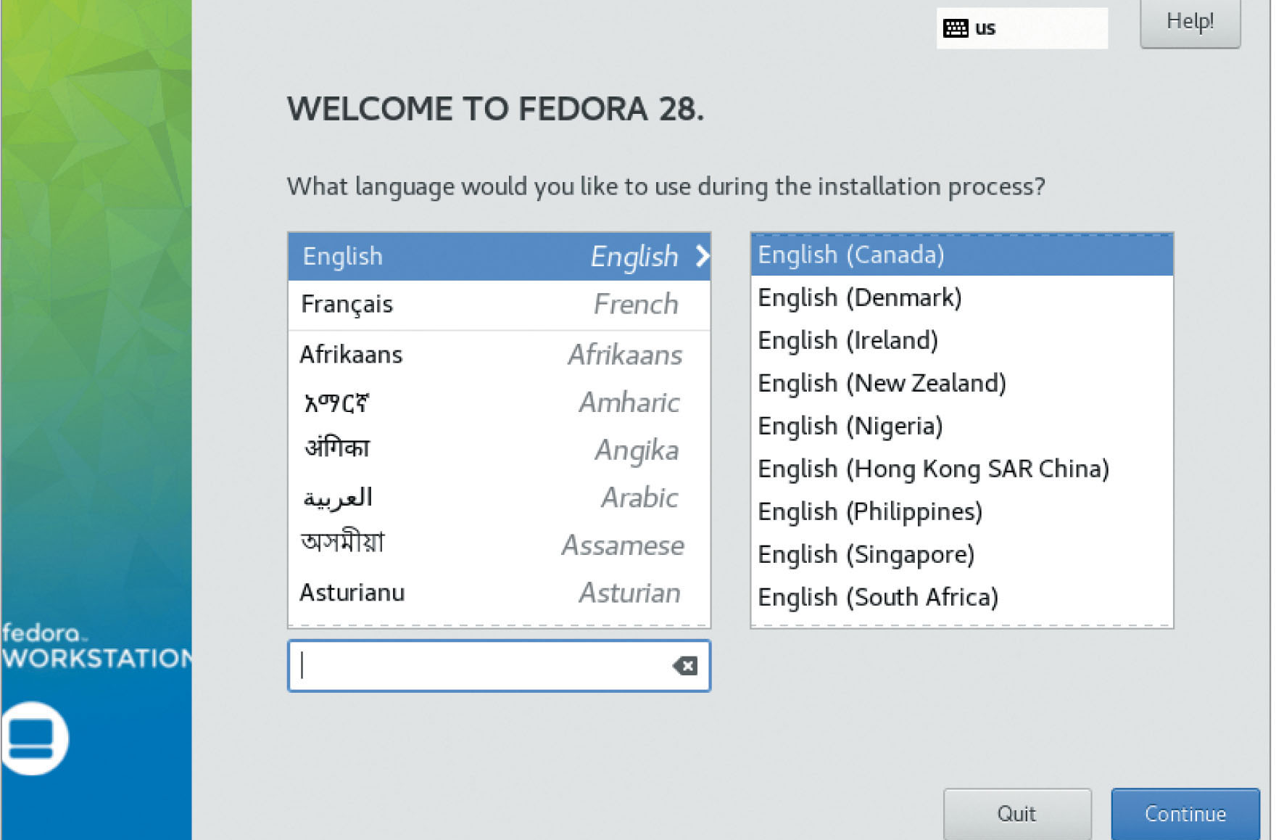
Choosing an Installation Language and Localization and System Options (2 of 4)
Figure 2-8 Selecting an installation language
Source: Red Hat, Inc

Slide 16
Choosing an Installation Language and Localization and System Options (3 of 4)
You must manually select an installation destination before installation can continue
Select a permanent storage device that will contain the Linux OS
Most common storage devices for storing Linux OS are hard disks
Parallel Advanced Technology Attachment (PATA)
Serial Advanced Technology Attachment (SATA)
Non-Volatile Memory Express (NVMe)
Small Computer Systems Interface (SCSI)
Serial Attached SCSI (SAS)

Slide 17
Choosing an Installation Language and Localization and System Options (4 of 4)
By clicking the Installation Destination icon you will be presented with a list of the different permanent storage devices
If you have multiple disk devices select the disk that will be used to contain Linux
You can also install Linux on an external iSCSI or FCoE Storage Area Network (SAN), Direct Access Storage Device (DASD), Multipath IO (MPIO), or firmware Redundant Array of Inexpensive Disks (RAID)

Slide 18
Configuring Disk Partitions and Filesystems (1 of 5)
Each hard disk is divided into partitions
Partitions are formatted with filesystems
Filesystem is a structure that specifies how data should reside on the hard disk
Maximum four primary partitions
Extended partition can be divided into logical drives
Master Boot Record (MBR)
Table of all partition information for a certain hard disk or SSD

Slide 19
Configuring Disk Partitions and Filesystems (2 of 5)
Filesystems can be accessed by Linux if it is attached (mounted) to a certain directory
Fedora installation program can automatically create partitions
Generally a good practice to manually partition
Linux typically requires only two partitions
Partition mounted to the root directory
Partition for virtual memory (swap memory)
Area on hard disk used to store information normally residing in physical memory (RAM)

Slide 20
Configuring Disk Partitions and Filesystems (3 of 5)
Different types of filesystems
Ext2, Ext3, Ext4, VFAT, and XFS
Journaling
Keeps track of the information written to the hard drive
Installation destination
Once selected, the installation program will prompt you to choose automatic or custom partitioning scheme

Slide 21
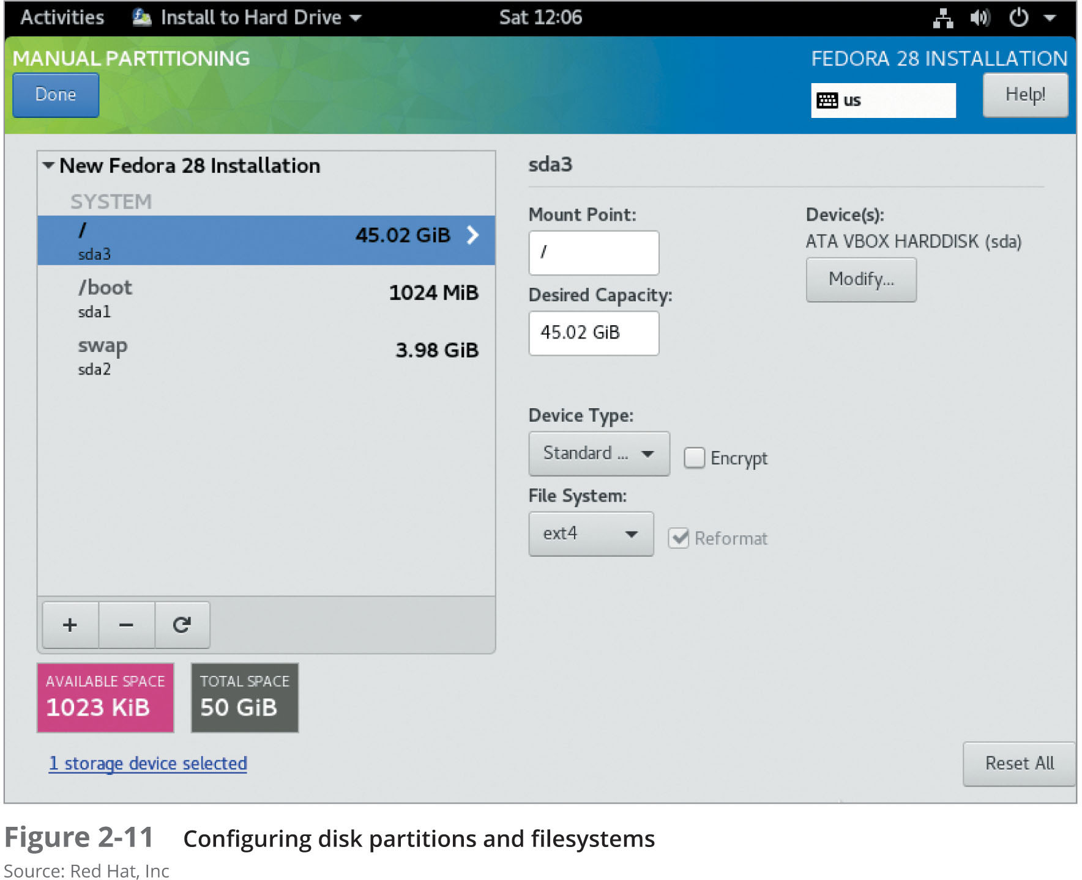
Configuring Disk Partitions and Filesystems (4 of 5)
Figure 2-11 Configuring disk partitions and filesystems
Source: Red Hat, Inc

Slide 22
Configuring Disk Partitions and Filesystems (5 of 5)
Instead of standard partitions, choose a partition scheme that creates logical volumes
Use the Logical Volume Manager (LVM)
Support the new B-tree Filesystem (BTRFS)
Easier system recovery
Choose a standard partition scheme
Ensure that contents of disk partitions are not encrypted

Slide 23
Configuring User Accounts
Authentication
Users log in via valid user name and password
Configure two user accounts
Administrator account (root): full rights to system
Regular user account: system administration tasks

Slide 24
Basic Linux Usage
Different types of user interface
Essential to understand
Basic tasks
Command execution
Obtaining online help
Shutting down the Linux system

Slide 25
Shells, Terminals, and the Kernel (1 of 4)
Terminal: channel allowing users to log on to the kernel locally or across a network
Shell: user interface which accepts user inputs and transfers them to the kernel
BASH Shell (Bourne Again Shell): default Linux shell
Linux can have many terminals that allow you to log in to the computer locally or across a network

Slide 26
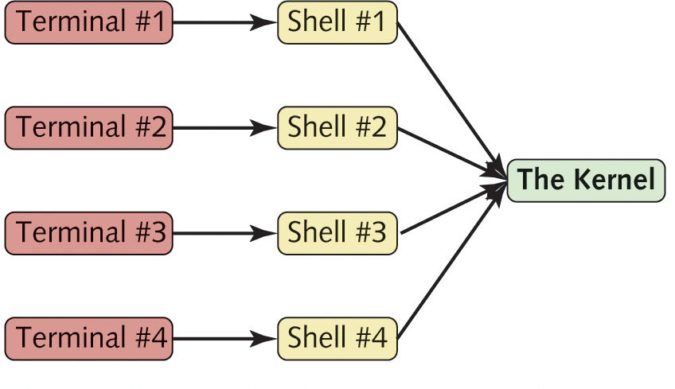
Shells, Terminals, and the Kernel (2 of 4)
Figure 2-13 Shells, terminals, and the kernel

Slide 27
Shells, Terminals, and the Kernel (3 of 4)
Graphical user interface
Start GUI environment on top of BASH shell
Switch to a graphical terminal
From the local server, use key combinations to change to separate terminal
Ctrl+Alt+F2
Command line prompt reflects the type of user that is logged in
Root user: #
Regular user: $

Slide 28
Shells, Terminals, and the Kernel (4 of 4)
Default GUI environment in Fedora Linux is GNOME
Command-line terminal may be accessed through the Activities menu in the upper left of the desktop
Navigate to Show Applications, Utilities, Terminal

Slide 29
Basic Shell Commands
Commands: indicate the name of program to execute
Case sensitive
Options: specific letters starting with a dash “-” and appear after command name
Alter the way the command works
Arguments: specify a command’s specific working parameters
Do not start with a dash

Slide 30
Shell Metacharacters
Metacharacters: keyboard characters with a special meaning
A $ tells the shell that the following text refers to a variable
Avoid use of metacharacters when typing commands unless using their special functionality
Single quotation marks ‘ ’ protect metacharacter from being interpreted specially by the shell

Slide 31
Getting Command Help (1 of 3)
Manual (man) pages: most common form of documentation for Linux commands
At command prompt, type the man command followed by command name
Manual pages
Contain different sections
Section numbers describe the category of the command in the manual page database
Searchable by keyword

Slide 32
Getting Command Help (2 of 3)
Table 2-8 Manual page section numbers
Manual page section | Description
1 | Commands that any user can execute
2 | Linux system calls
3 | Library routines
4 | Special device files
5 | File formats
6 | Games
7 | Miscellaneous
8 | Commands that only the root user can execute
9 | Linux kernel routines
n | New commands not categorized yet

Slide 33
Getting Command Help (3 of 3)
GNU info pages
Originally intended to replace the man command in Linux
At command prompt, type the info command followed by a command name
Some commands do not have manual or info pages
Usually functions that are built into the BASH shell

Slide 34
Shutting Down the Linux System (1 of 2)
OS handles writing data from computer memory to the disk drives
Simply turning off power to the computer might result in damaged user and system files
Shutdown command
Can halt or reboot your computer after a certain period of time

Slide 35
Shutting Down the Linux System (2 of 2)
Table 2-9: Commands to halt and reboot the Linux operating system
Command | Description
shutdown –P +4 | Powers off your system in four minute
shutdown –H +4 | Halts the operating system from executing in four minutes, but does not invoke the ACPI function in your BIOS to turn off power to your computer
shutdown –r +4 | Reboots your system in four minutes
shutdown –P now | Powers off your system immediately
shutdown –r now | Reboots your system immediately
shutdown –c | Cancels a scheduled shutdown
halt | Halts your system immediately, but does not power it off
poweroff | Powers off your system immediately
reboot | Reboots your system immediately

Slide 36
Summary (1 of 2)
Prior to installation, verify hardware requirements and compatibility
You can obtain Linux installation media by downloading an ISO image from the Internet
Typical Linux installation prompts for language, date, time zone, keyboard layout, network configuration, user account configuration, and permanent storage configuration

Slide 37
Summary (2 of 2)
Users must log in to a terminal and receive a shell before they are able to interact with the Linux system and kernel
Regardless of the type of terminal, you can enter commands, options, and arguments at a shell prompt to perform system tasks, obtain command help, or shut down the Linux system. The shell is case sensitive and understands a variety of special characters called shell metacharacters, which should be protected if their special meaning is not required

